Slide 1
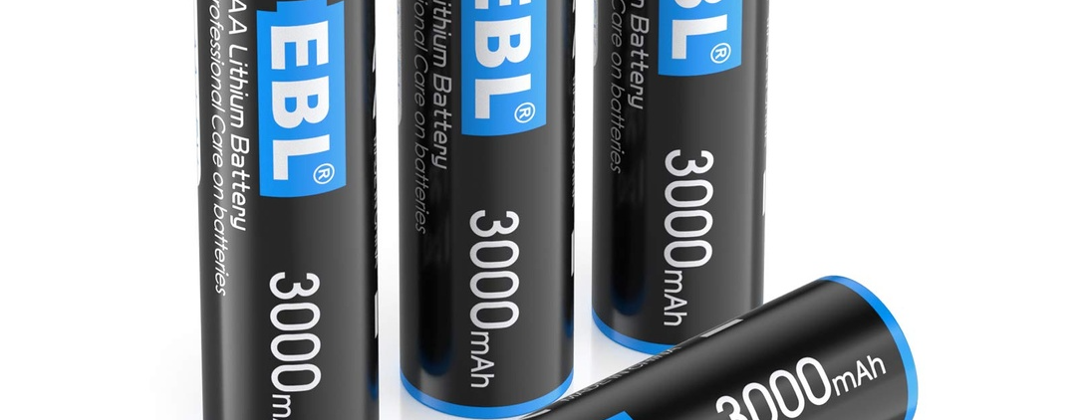
How Lithium Batteries Work
EEM451 - Samet Bayat - 22293730

Slide 2
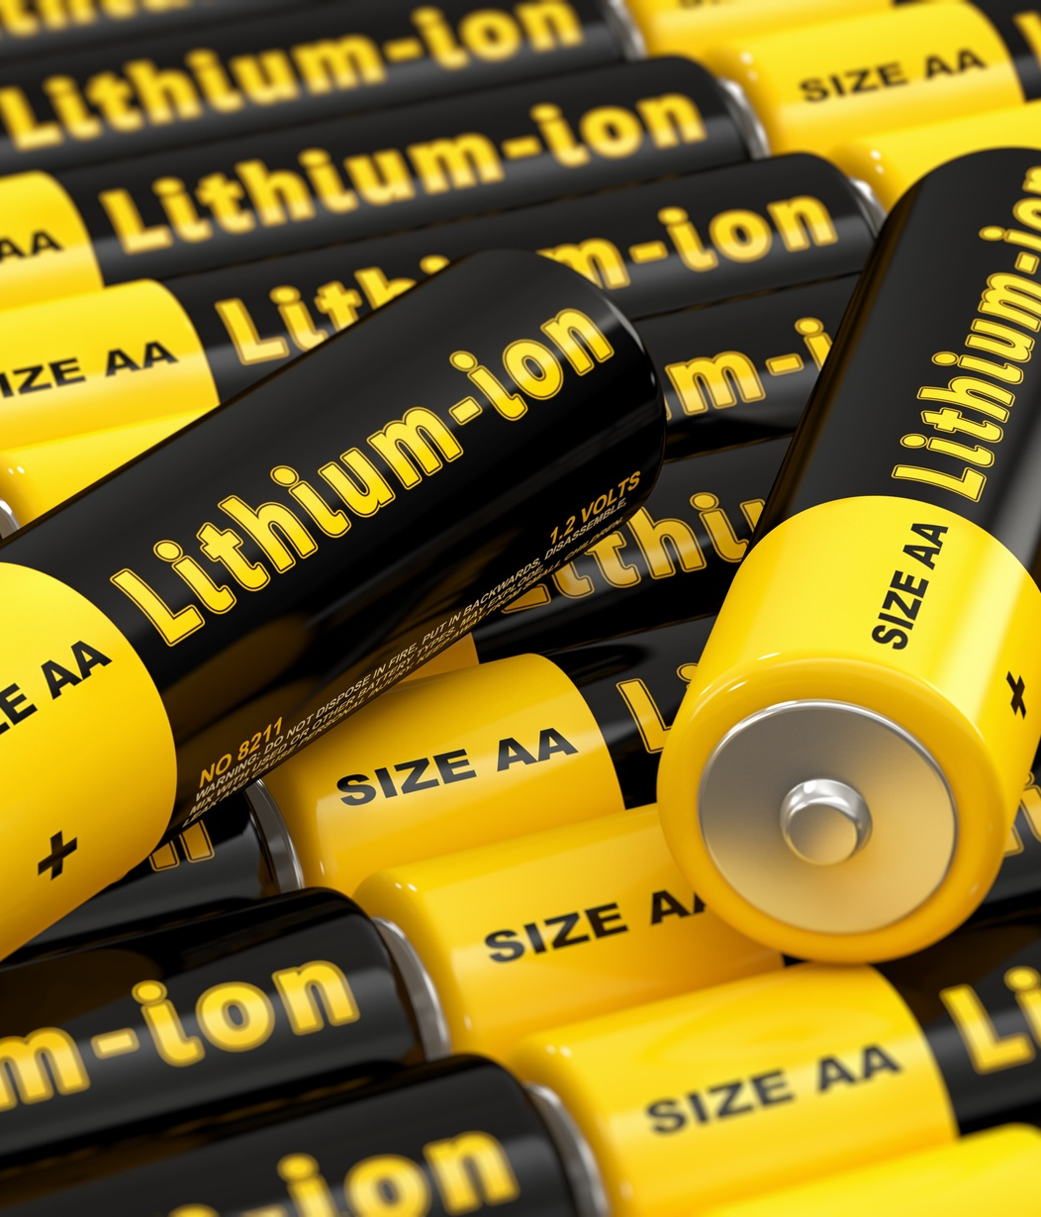
Lithium batteries are rechargeable batteries that use lithium ions as the charge carriers. They have higher energy density and lower self-discharge rate compared to other rechargeable batteries, making them useful for many applications like cell phones and electric vehicles. Lithium batteries work by shuttling lithium ions between the cathode and anode when charging and discharging.

Slide 3
History
1980
2008
Exxon prototype lithium battery developed.
Tesla releases first mass production electric car using lithium-ion batteries.
1991
Sony commercializes first lithium-ion battery.

Slide 4
Components
Cathode
Anode
The cathode supplies electrons to the external circuit and is oxidized during the electrochemical reaction.
The anode accepts electrons from the external circuit and is reduced during the electrochemical reaction.
Electrolyte
Separator
The electrolyte allows ionic transport between the cathode and anode to balance the flow of electrons in the external circuit.
The separator physically separates the cathode and anode compartments while allowing ionic transport through the electrolyte.

Slide 5



Chemistry
Oxidation reaction at the anode
Reduction reaction at the cathode
Ionic conduction
Lithium atoms lose electrons and become lithium ions. This oxidation reaction releases electrons that flow through the external circuit.
Lithium ions and electrons recombine at the cathode. This reduction reaction consumes electrons coming from the external circuit.
Lithium ions flow through the electrolyte from the anode to the cathode while the battery discharges.

Slide 6




High energy density
No memory effect
Advantages
Low self-discharge
High cell voltage

Slide 7
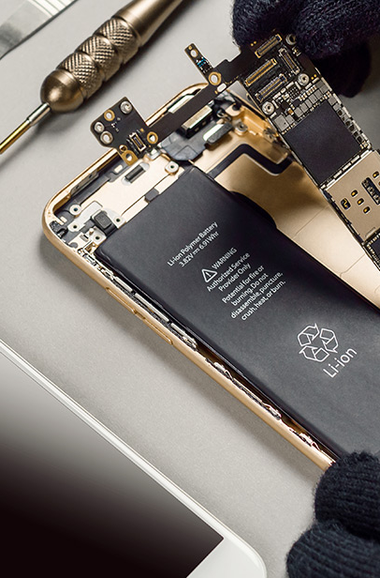
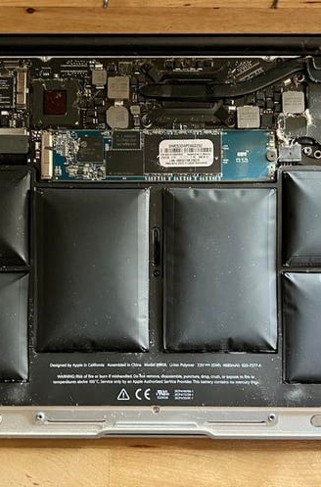
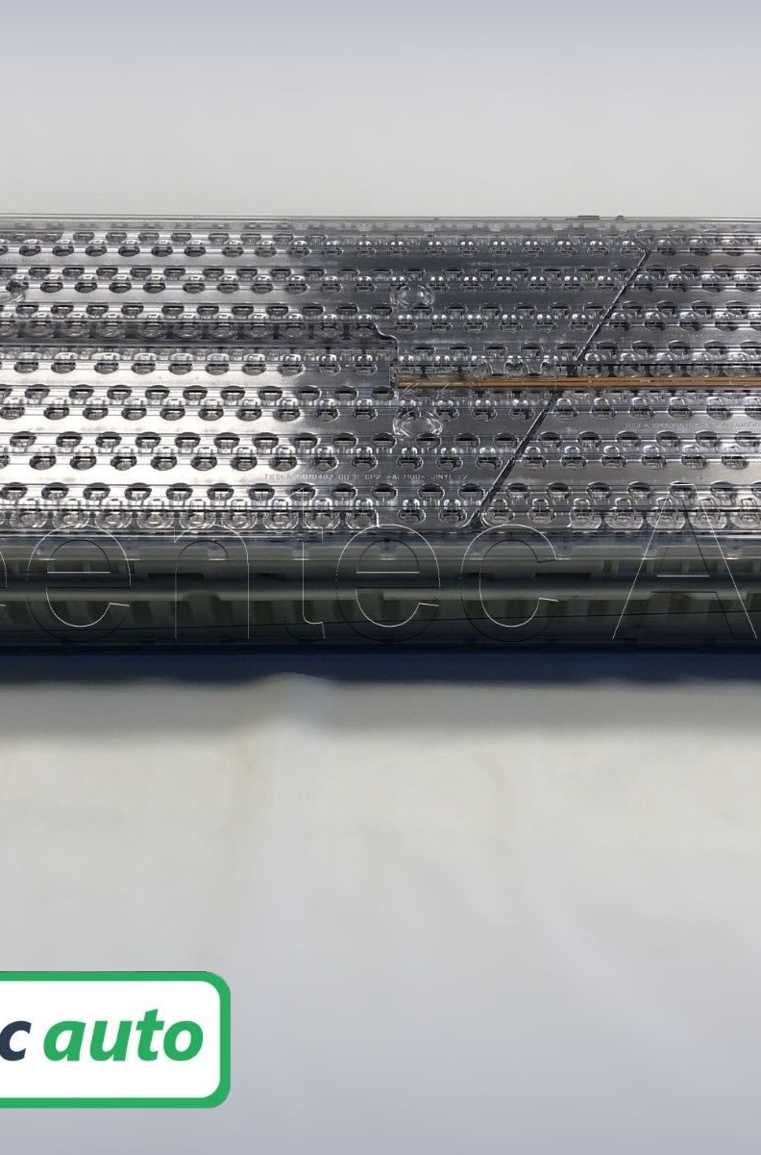

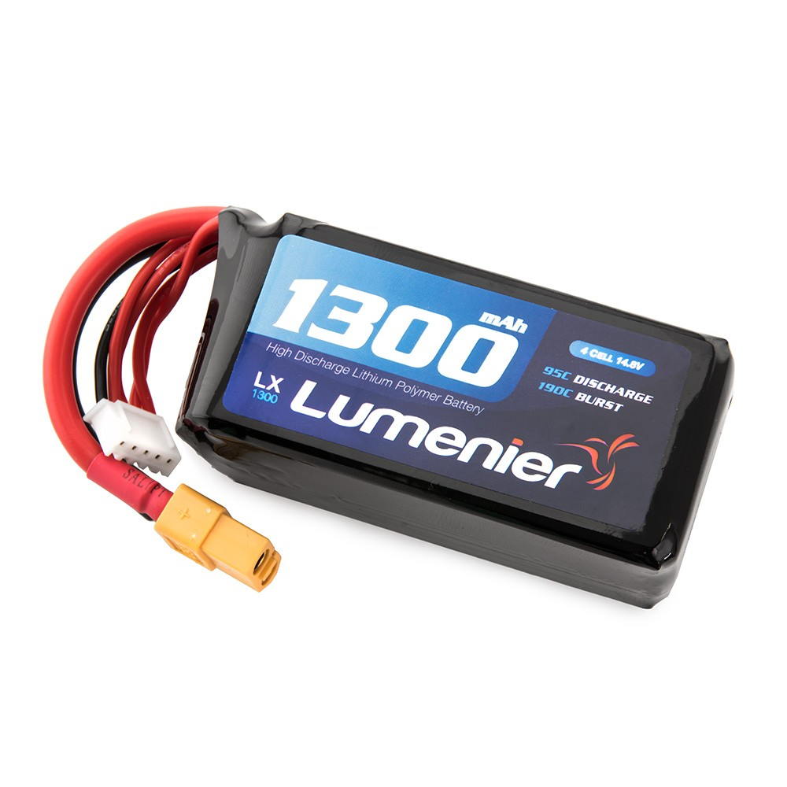
Applications
Smartphones
Laptops
Electric vehicles
Power tools
Drones
Lithium-ion batteries power most smartphones, allowing them to be small and portable while still having sufficient battery life.
Laptops use lithium-ion batteries to be lightweight and portable while still providing hours of use on a single charge.
Electric vehicles like Tesla use large lithium-ion battery packs to store the energy that powers the electric motor.
Cordless power tools like drills use lithium-ion batteries so they can be used anywhere without a power cord.
Drones use lithium polymer batteries which are lightweight to allow longer flight times.

Slide 8



Safety
Risk of fire or explosion
Exposure to chemicals
Proper handling and storage
Lithium batteries can overheat and catch fire if damaged, exposed to high temperatures, or improperly charged.
A damaged lithium battery can leak toxic and corrosive electrolytes.
Store lithium batteries in cool, dry places away from moisture, and handle them carefully to prevent damage.
Lithium batteries are safe when properly used, but can pose hazards if mishandled or damaged. Take care when using, charging, and storing them.

Slide 9
Recycling
Collection
Lithium batteries are collected through battery recycling programs and initiatives. Consumers can return old lithium batteries to designated collection points.
Sorting and dismantling
Collected batteries are sorted by chemistry and size, then dismantled to separate battery components like metals, plastics and electrolytes.
Pyrometallurgical processing
Batteries are fed into a high-temperature smelting furnace to recover metals like cobalt, nickel and copper.
Hydrometallurgical processing
Leached solutions undergo purification and precipitation processes to isolate lithium carbonate and cathode metals.
Reuse
Recycled metals and compounds are reused to manufacture new lithium batteries, reducing the need for new mineral extraction.

Slide 10
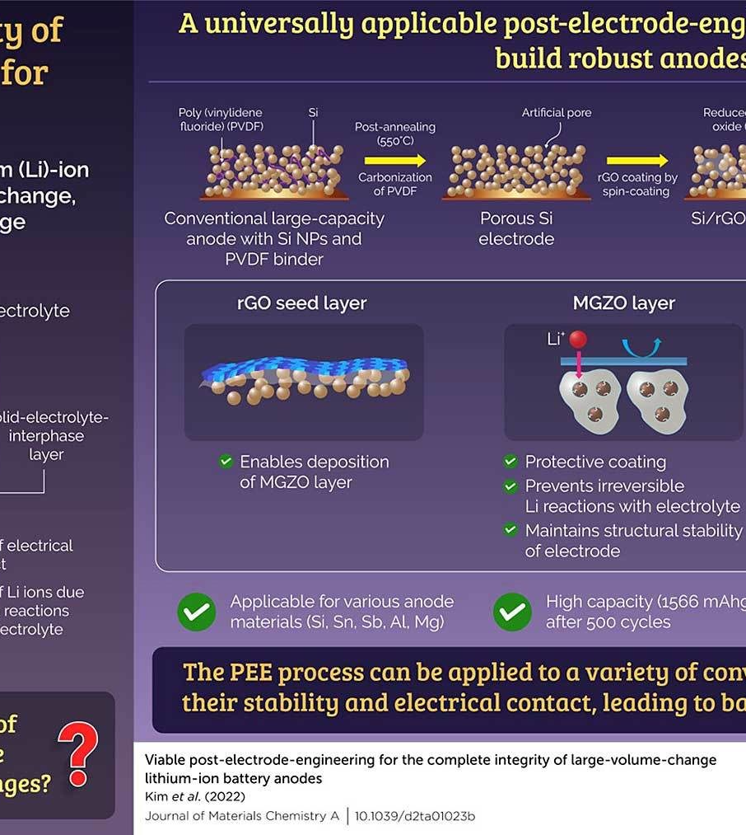
The Future
Emerging research points to new electrolyte formulations and electrode materials that can significantly improve the energy density and cycle life of lithium-ion batteries. Advances like lithium sulfide and lithium metal anodes, as well as solid-state electrolytes, hold promise for the next generation of lithium batteries with 2-3x higher capacity than current designs.

Slide 11
Conclusions
High Energy Density
Long Cycle Life
Low Self-Discharge
Lithium batteries have very high energy density compared to other battery chemistries, allowing more energy to be stored in a smaller, lighter package.
Lithium batteries can withstand hundreds to thousands of charge/discharge cycles.
Lithium batteries experience less than 5% self-discharge per month, allowing them to retain charge when not in use.
Safety Concerns
Environmental Impact
Lithium batteries can overheat and catch fire if overcharged, short-circuited or damaged physically.
Lithium mining and battery disposal/recycling raise environmental concerns due to toxicity.

Slide 12
References
- "Rechargeable Li-Ion OEM Battery Products". Panasonic.com. Archived from the original on 13 April 2010. Retrieved 23 April 2010.
- Erol, Salim (5 January 2015). Electrochemical Impedance Spectroscopy Analysis and Modeling of Lithium Cobalt Oxide/Carbon Batteries (PhD). Retrieved 10 September 2018.

